Slide 1


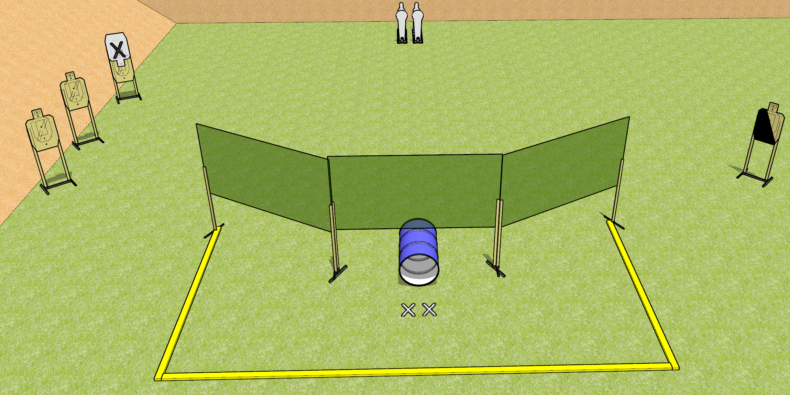
 | Dothan Gun Club – USPSA Match Get Down Course Designer : Drew Coleman
START POSITION : Standing with both feet on X’s, wrists below belt
GUN READY CONDITION : Pistol loaded and holstered. PCC loaded, shouldered, safety on, pointed at barrel |  | SCORING: Comstock, 12 rounds TARGETS: 4 paper, 4 Steel SCORED HITS: Best 2 on paper, steel until down START-STOP: Audible, last shot RULES:
STAGE PROCEDURE: Engage targets as they become available from within the fault lines.

Slide 2
Stage Name
Written Stage Briefing
Get Down is a 12 round, 60 point, Comstock Short Course. There are four USPSA targets, two Colt Poppers, and two mini poppers. The best two hits on paper will score and steel must fall to score. The start signal is audible.
Handgun start position is standing with both feet on X’s, wrists below belt. Handgun is loaded and holstered.
PCC start position is standing with both feet on X’s. Loaded carbine is held with both hands, safety on, shouldered, pointed at barrel.
Upon start signal, engage the targets as they become available from within the fault lines. The blue barrel on the ground is considered a port and may be shot through. The areas above and to the sides of the barrel are NOT a port.

